Slide 1




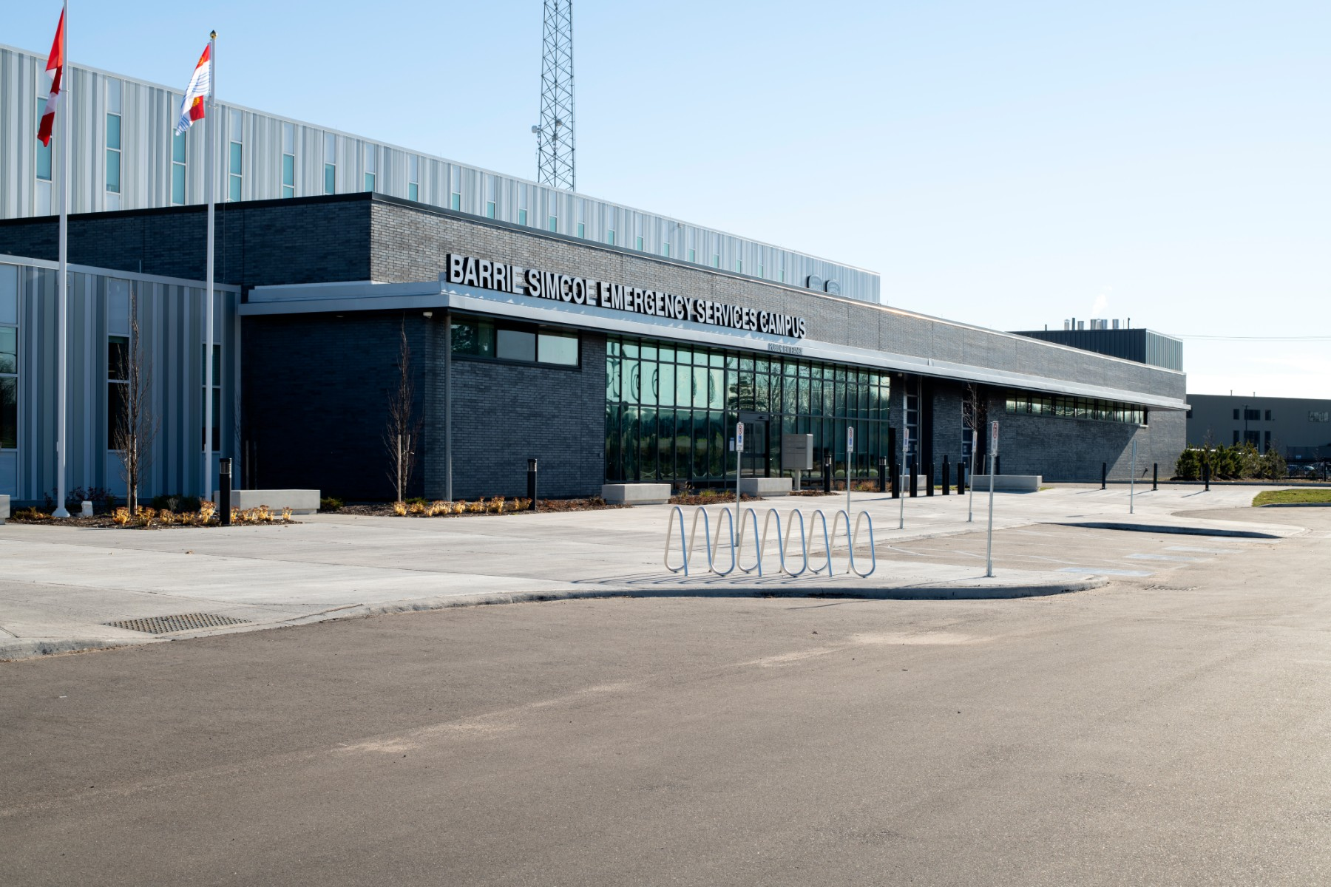

Dispatch Simulator
Capstone Project
Final Presentation

Slide 2
Project Summary
The county's health department was seeking to leverage AI system that would help improve the overall quality of service to stakeholders.
As a first step, we have developed a dispatch call simulator for the county. A simulator that could give resource allocation to the county, so that there is no need to allocate resources manually.
The system that provides reliable and useful data for resource allocation. This could also enable the county to allocate resources effectively across different types of emergencies.

Slide 3
Project Summary
The project involved data analysis, data preparation, model training and evaluation.
The project has been developed by incorporating ethical considerations, including protecting sensitive data.

Slide 4

What about Data?
The data was provided by Simcoe County Health and Emergency Services.
The data covers a period of time from 2015 to 2022.
The data includes various types of information such as geographic, emergency calls, priorities and time.
The data provided was raw, so it has been preprocessed and cleaned before using it for model training.

Slide 5

Team Profiles
Education
Bachelors in Computer Application (St. Xavier’s College, Ahmedabad)
Experience
Django Developer Intern (Silverwing Technologies Pvt. Ltd.) (6 months)
Skills
Python, MySQL, Django, Data Analytics, Power BI, Conversational AI, Git, Linux, Machine Learning
LinkedIn
https://www.linkedin.com/in/jay-mangukiya-41b38117a/
Jay Sureshbhai Mangukiya

Slide 6

Team Profiles
Education
Business Analytics (Seneca College)
Master in Mathematics (Banasthali Vidhyapith, Rajasthan)
Experience
Plant Operational Intern (Anaergia, Ontario) (10 Months)
BI Technical Consultant (Pragmasys Consulting LLP, Haryana) (10 Months)
Data Analyst (Eaton, India) (1 Year)
Skills
Power BI, Python, QlikView, SQL, Mathematics, Tableau, Data Analysis, Machine Learning, Conversational AI
LinkedIn
https://www.linkedin.com/in/nisha-siwach-42416b186/
Nisha Siwach

Slide 7

Team Profiles
Education
Bachelors in Computer Application (Kaveri College of Arts Commerce and Science, Pune)
Skills
Python, Arduino, Artificial Intelligence, C++, Java, Problem Solving, Analytical Skill
Obtained Python Programming certification from IIT Bombay Symposium
LinkedIn
https://www.linkedin.com/in/akshay-thakare-b0505220a/
Akshaykumar Thakare

Slide 8
SDLC
Maintenance
Once the application is deployed after testing, the final step is to discover bugs that slipped through the cracks during testing and resolving them.
This can be an iterative process.
Planning
Identifying current problems
Defining roles and responsibility
Calculation of labor and material costs
Timeline with goals
Testing
Testing each and every part and functions of the project continuously.
Ensuring that each function runs as it should be and each part of the application is interacting well with other parts.
Analysis
Gathering required documents
Define what features needs to be included and roadblocks along the way
Resources available to attain our goals
Design
Defining how our application will work, what programming language will be used, measures that will be taken to ensure the security of the application
How application will communicate, its architecture, and its hosting platform.
Implementation
The phase where actual program itself will written out.

Slide 9
Coding Journey

Slide 10
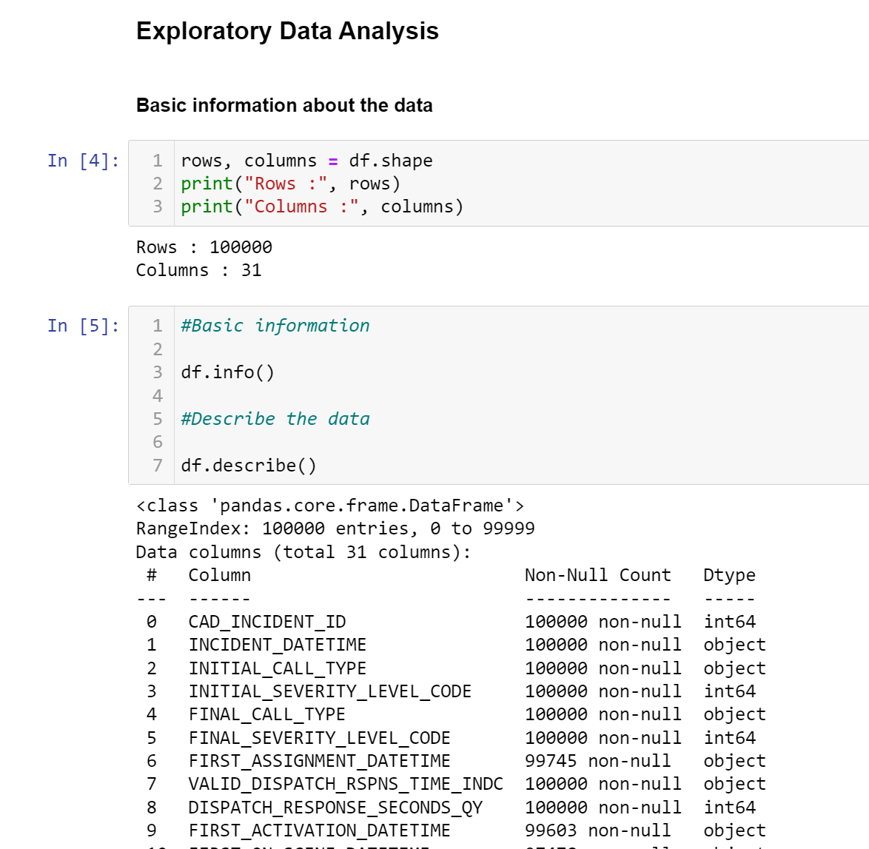
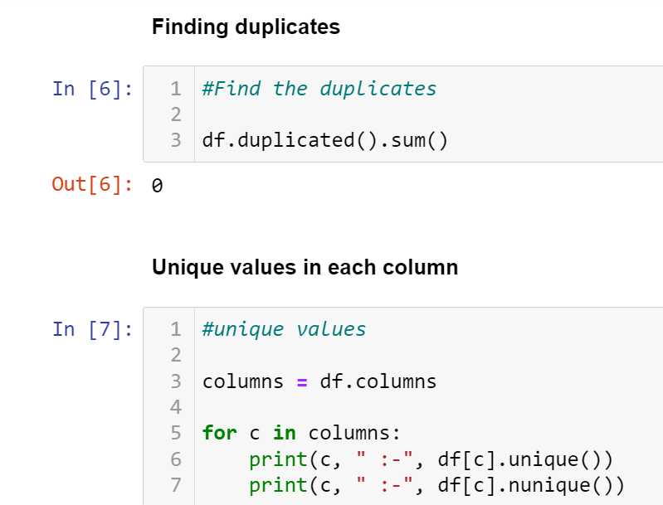
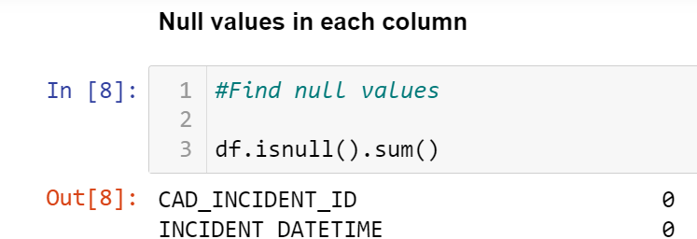
Working on Dummy Data

Slide 11
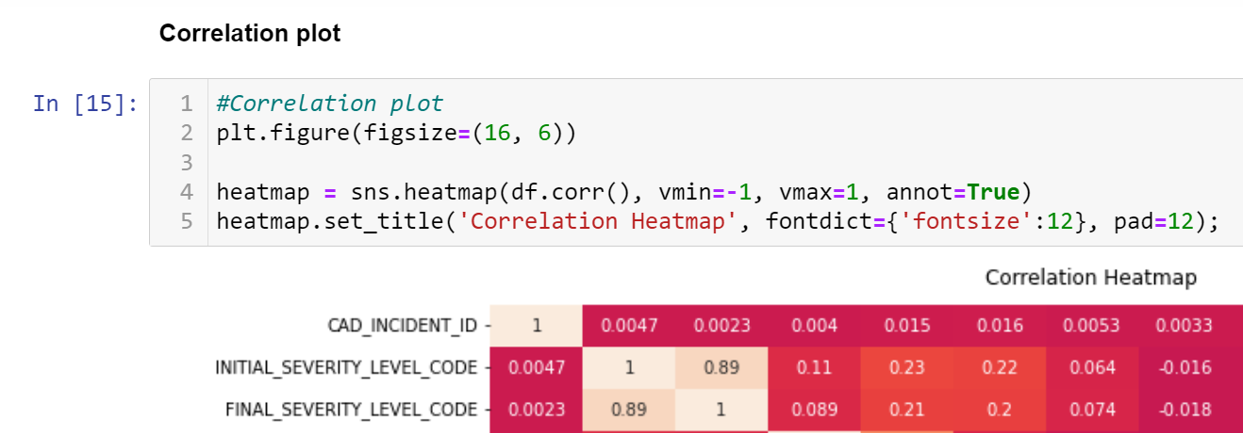
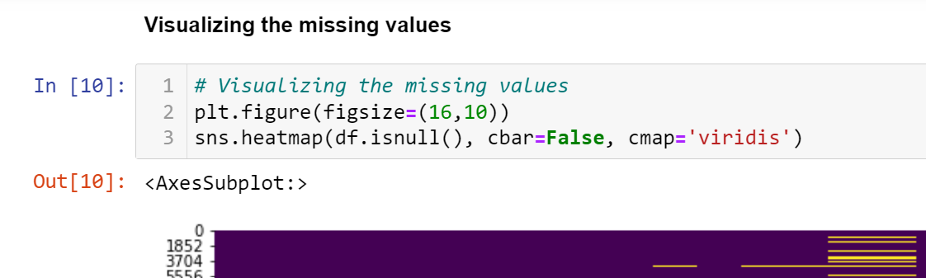
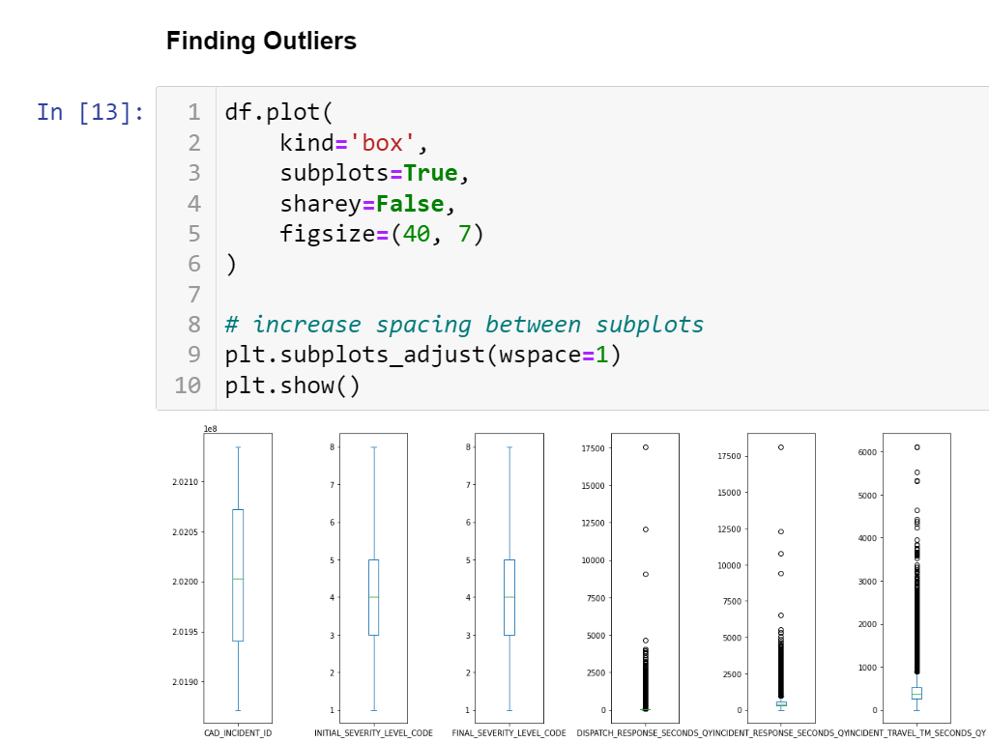
Working on Dummy Data

Slide 12
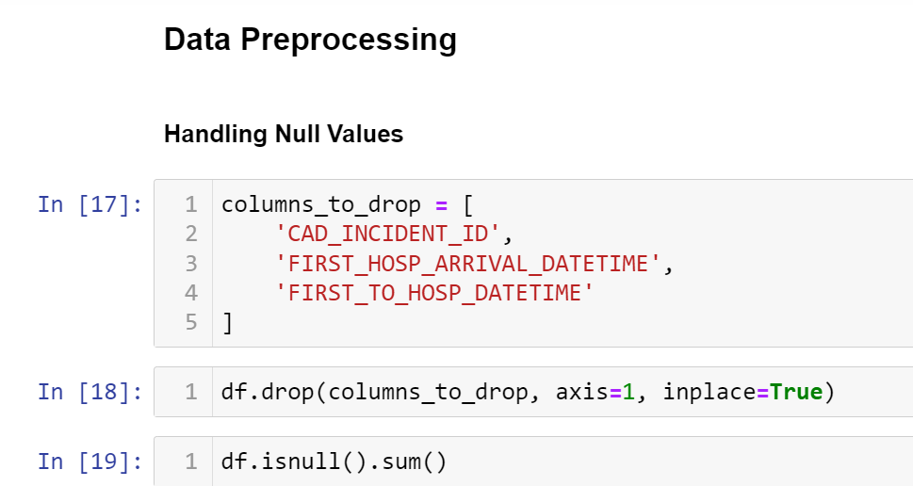
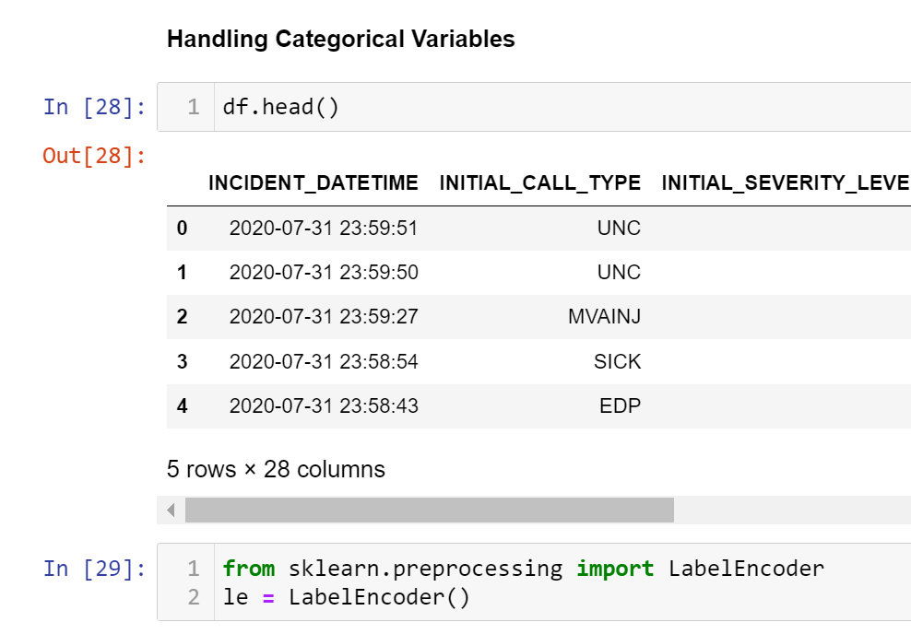
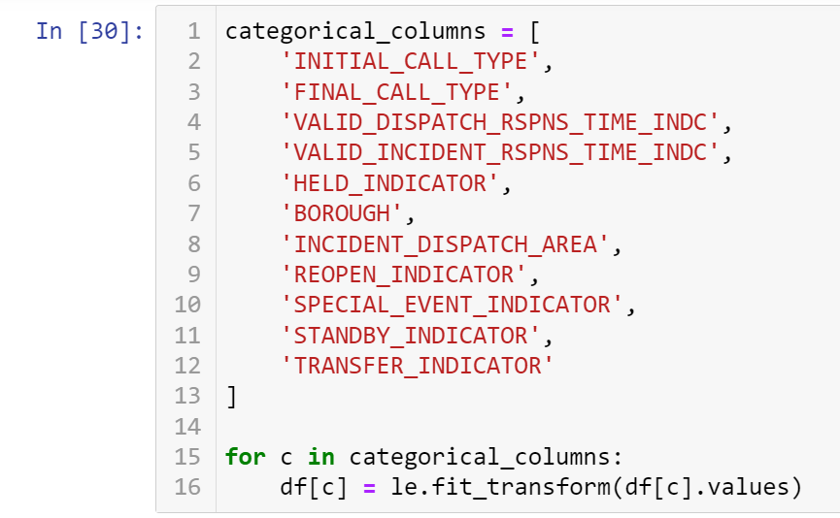
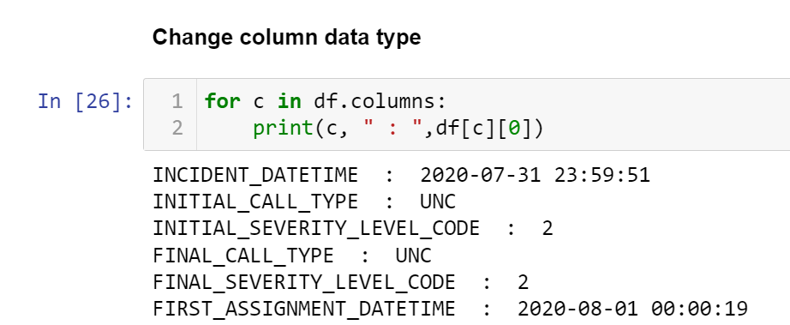
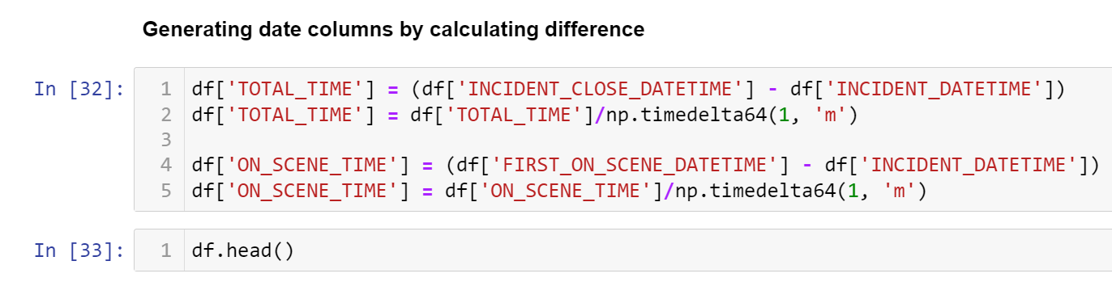
Working on Dummy Data

Slide 13
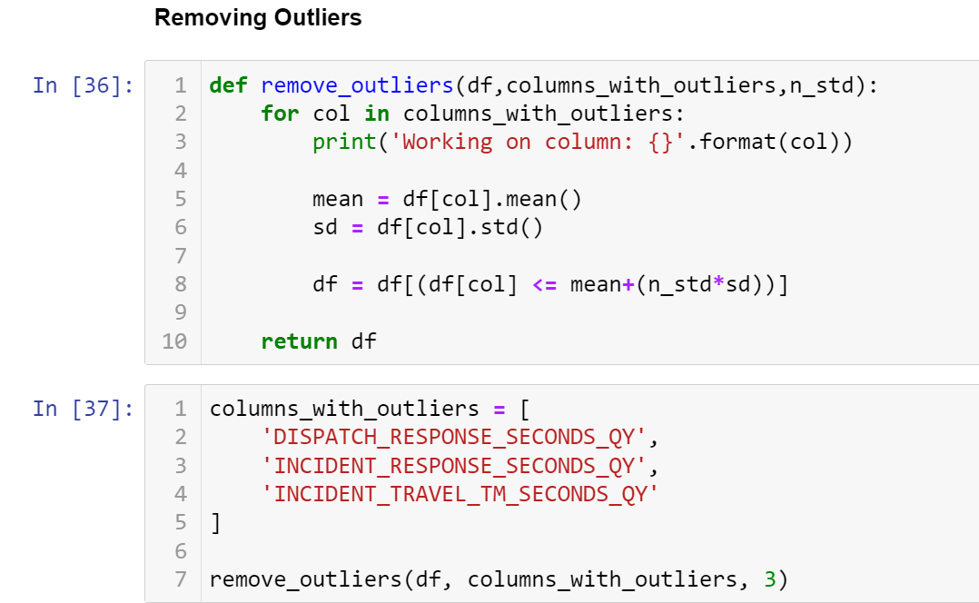
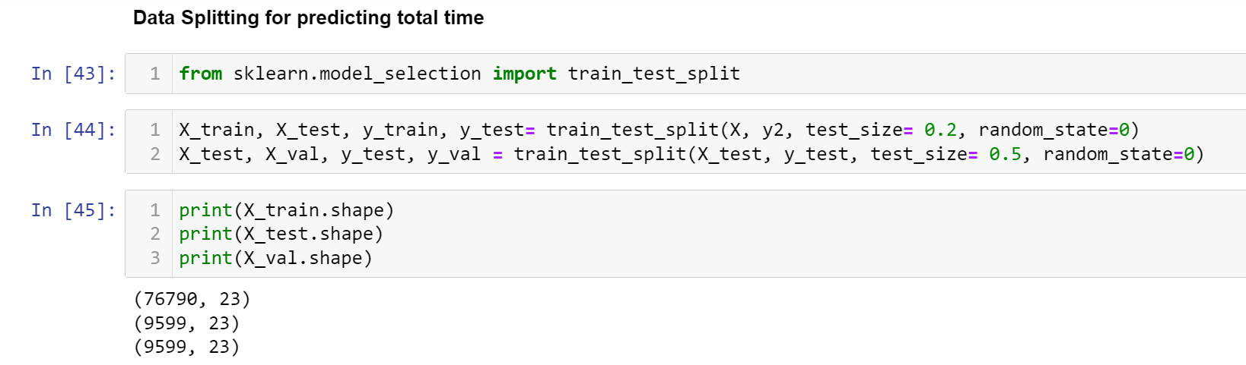
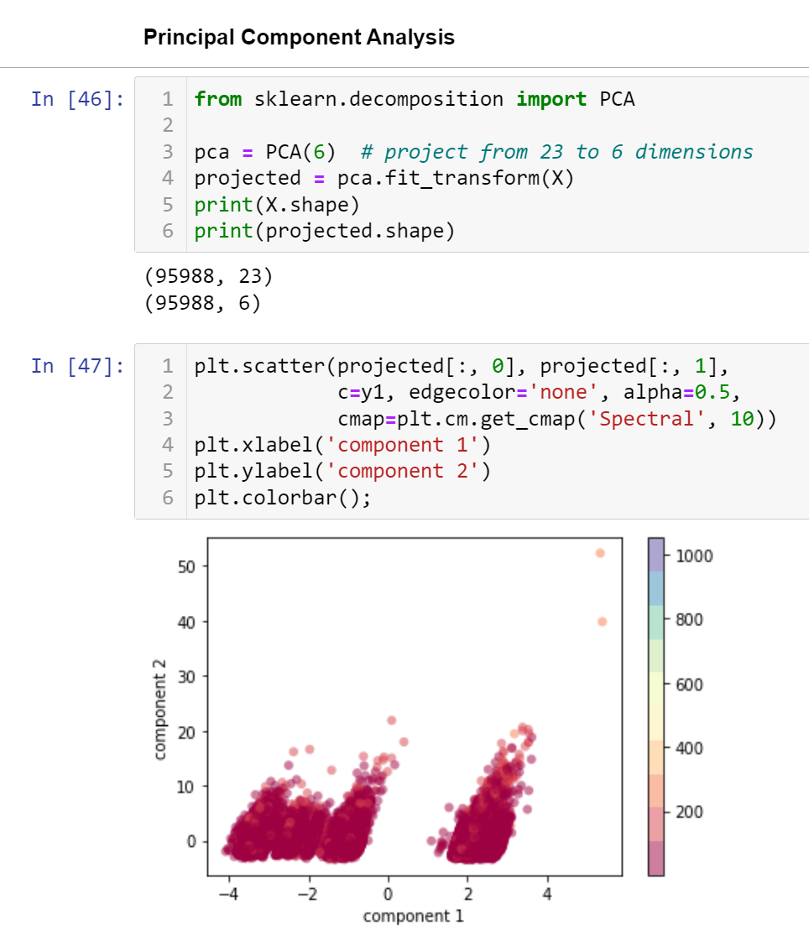
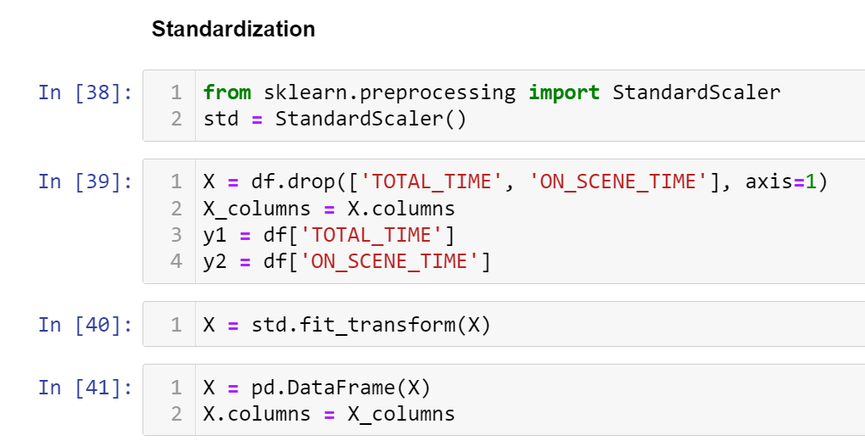
Working on Dummy Data

Slide 14
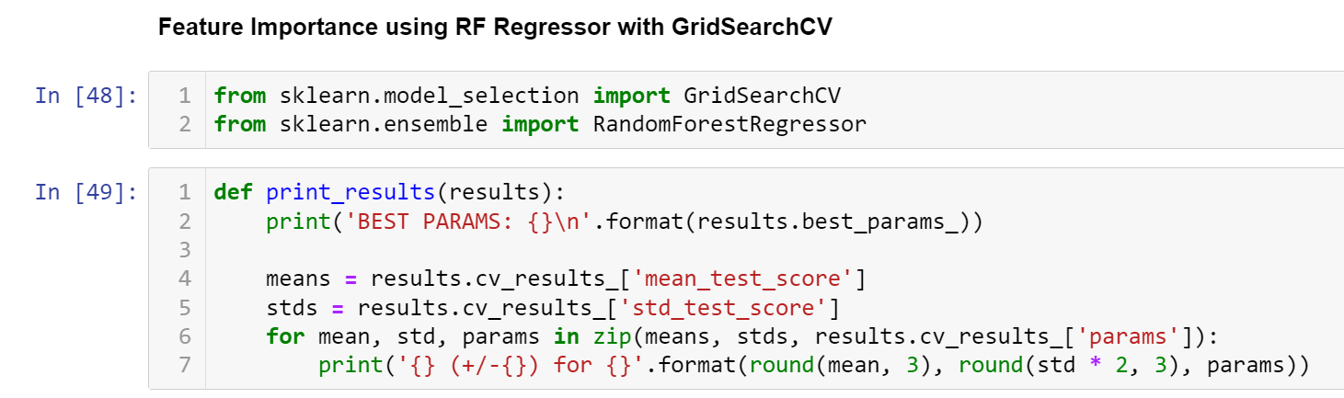
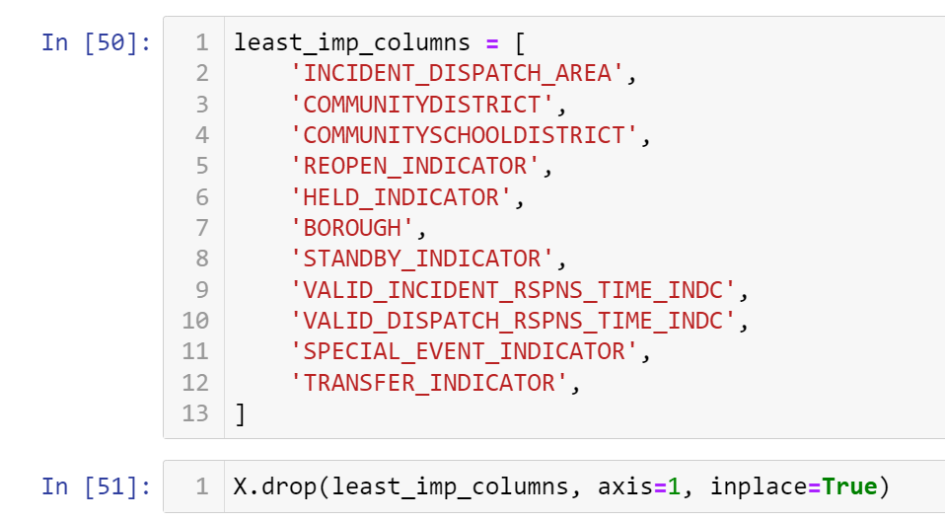
Working on Dummy Data

Slide 15
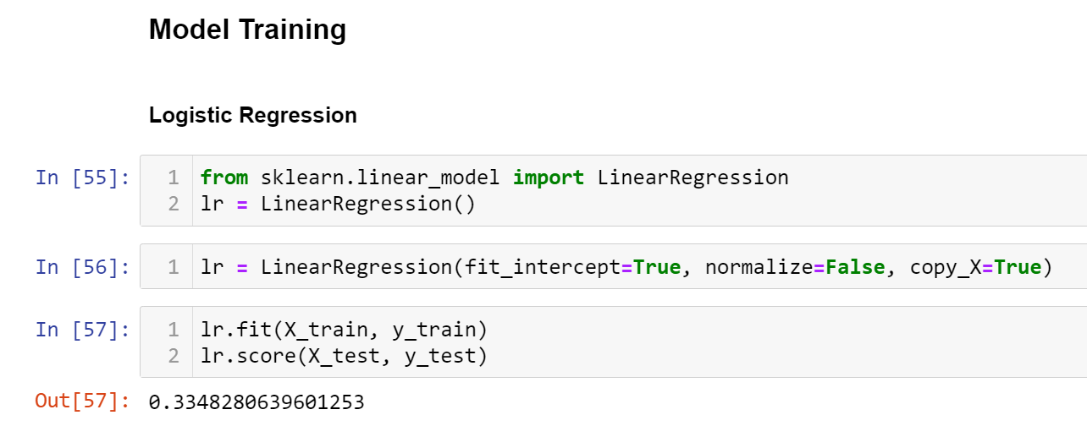
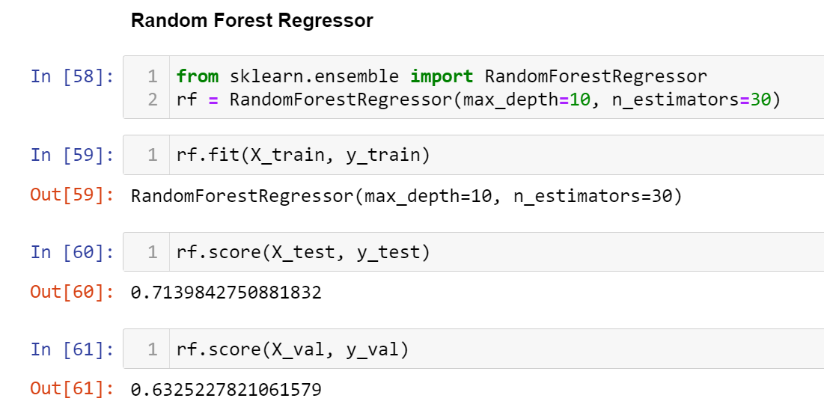
Working on Dummy Data

Slide 16
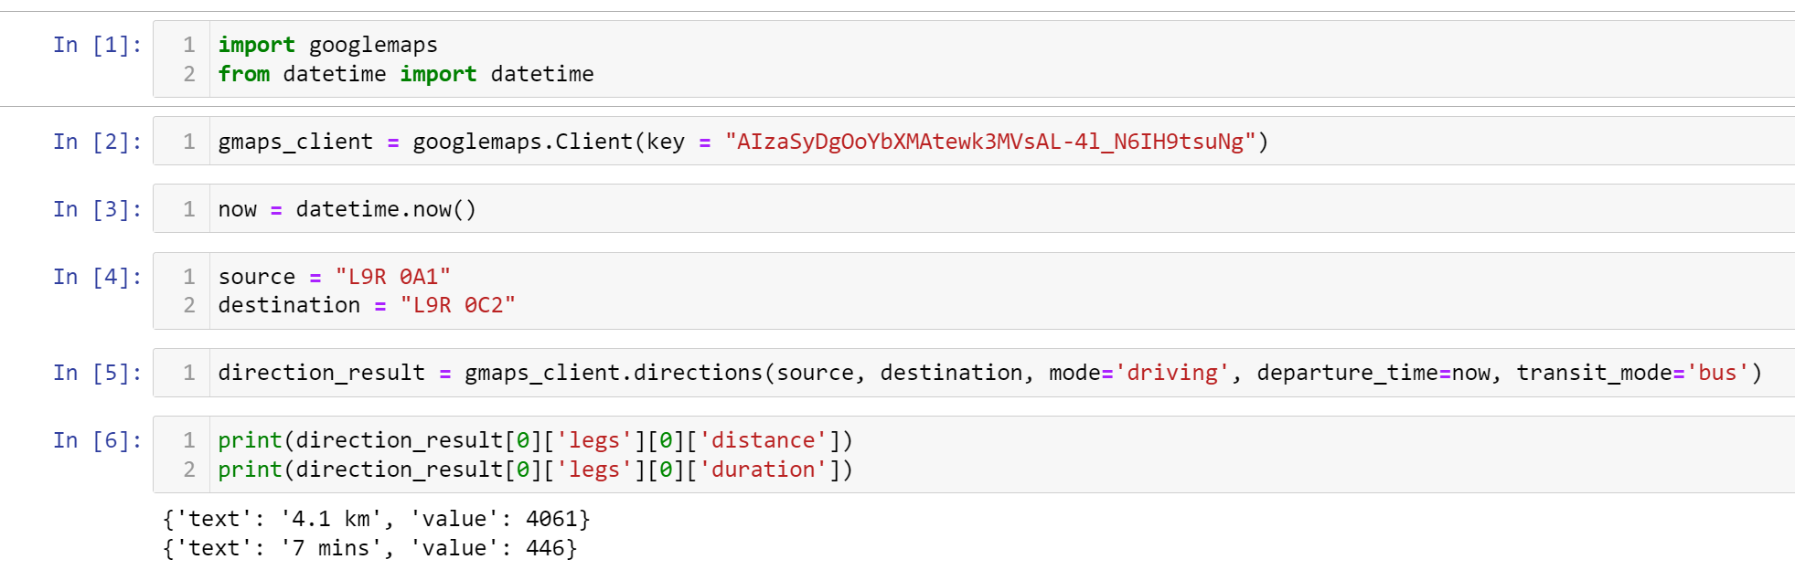
Working on Dummy Data

Slide 17
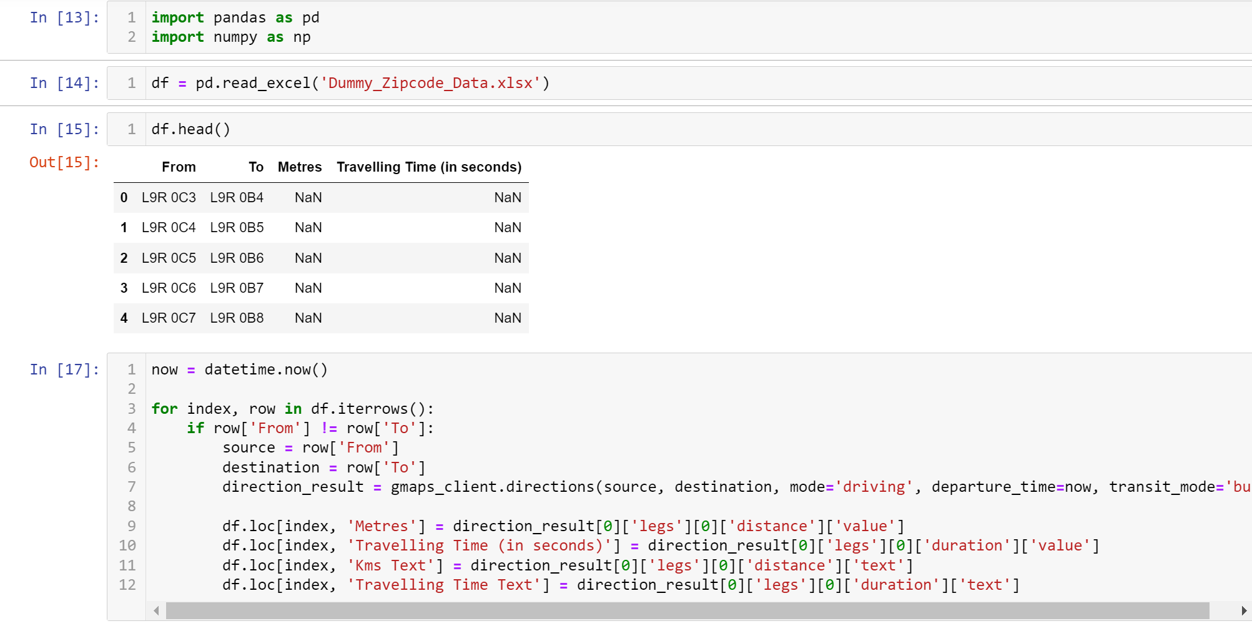
Working on Dummy Data

Slide 18
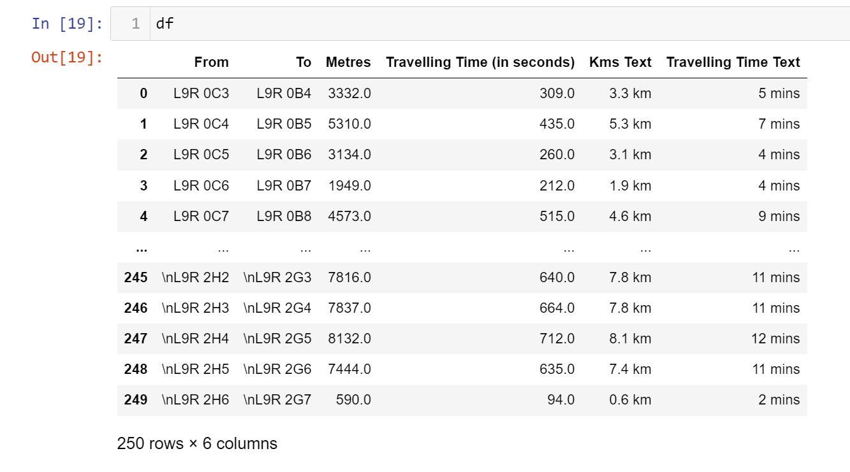
Working on Dummy Data

Slide 19
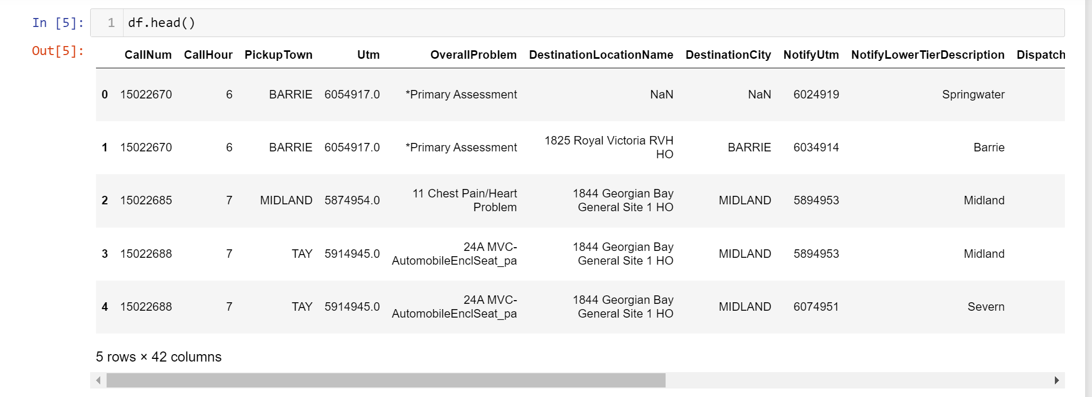
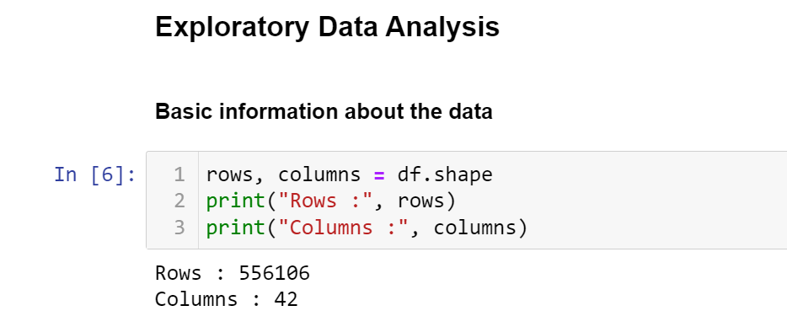
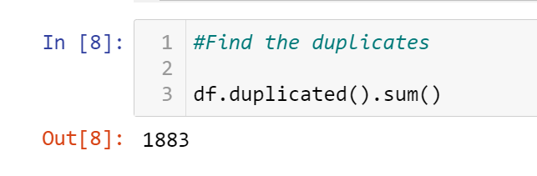
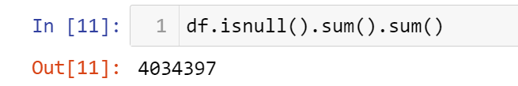
Working on Actual Data

Slide 20
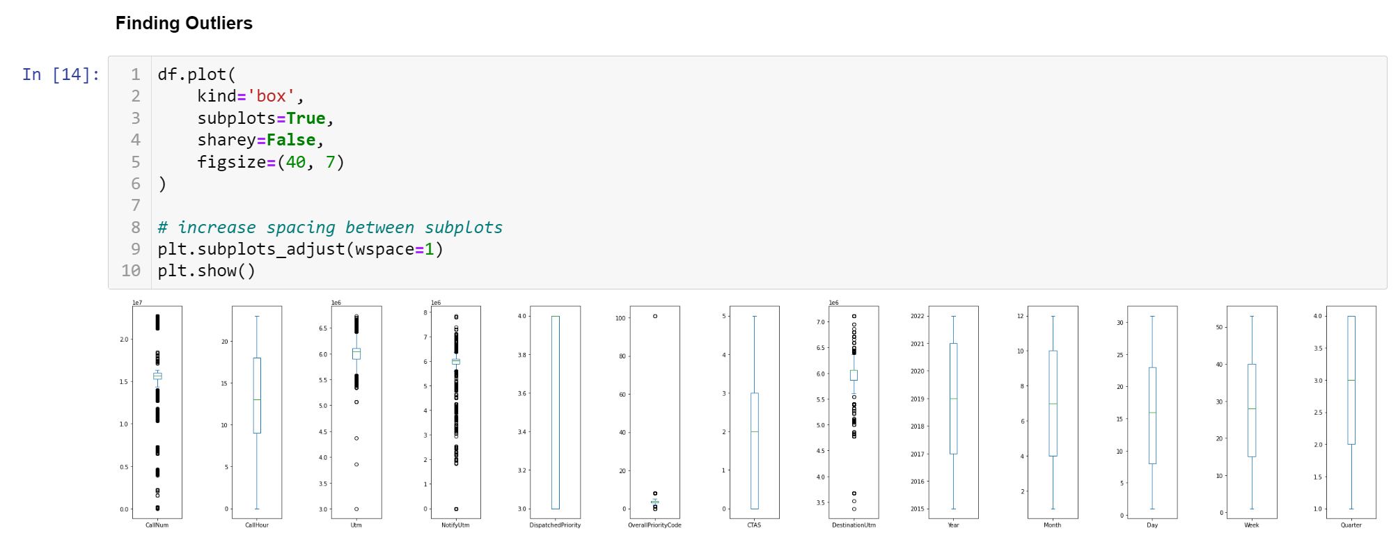
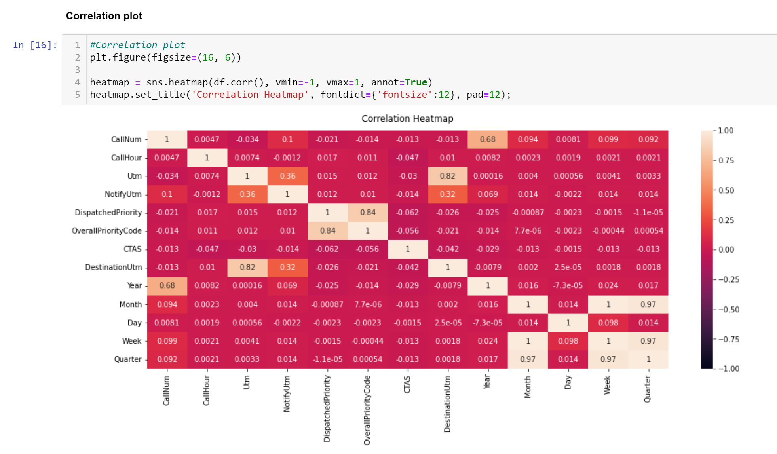
Working on Actual Data

Slide 21
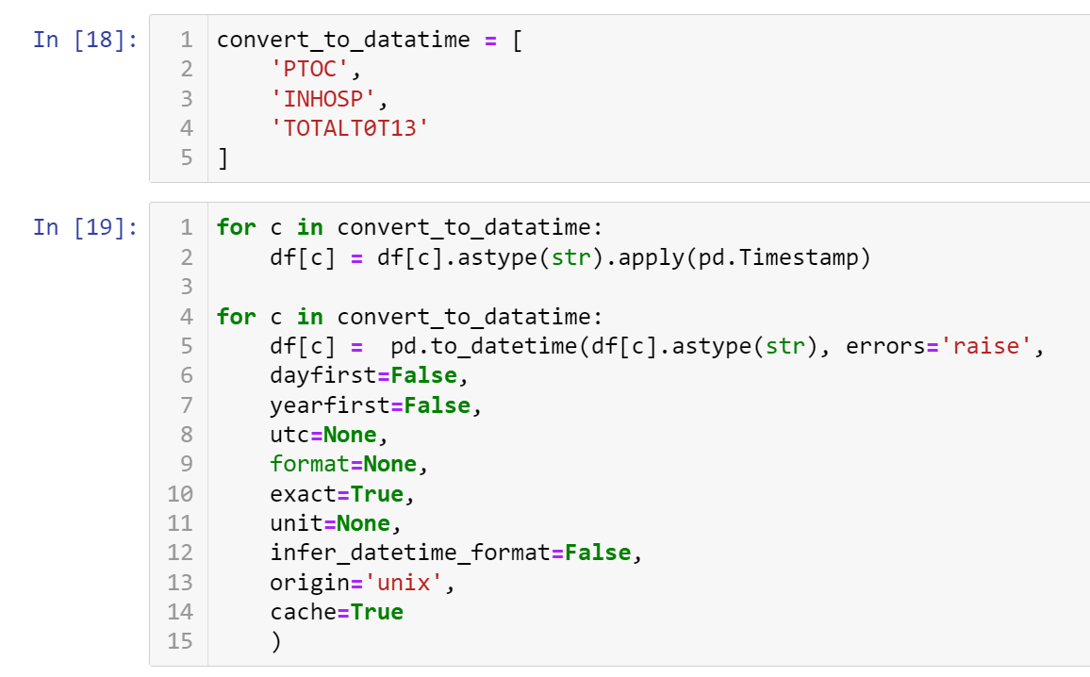
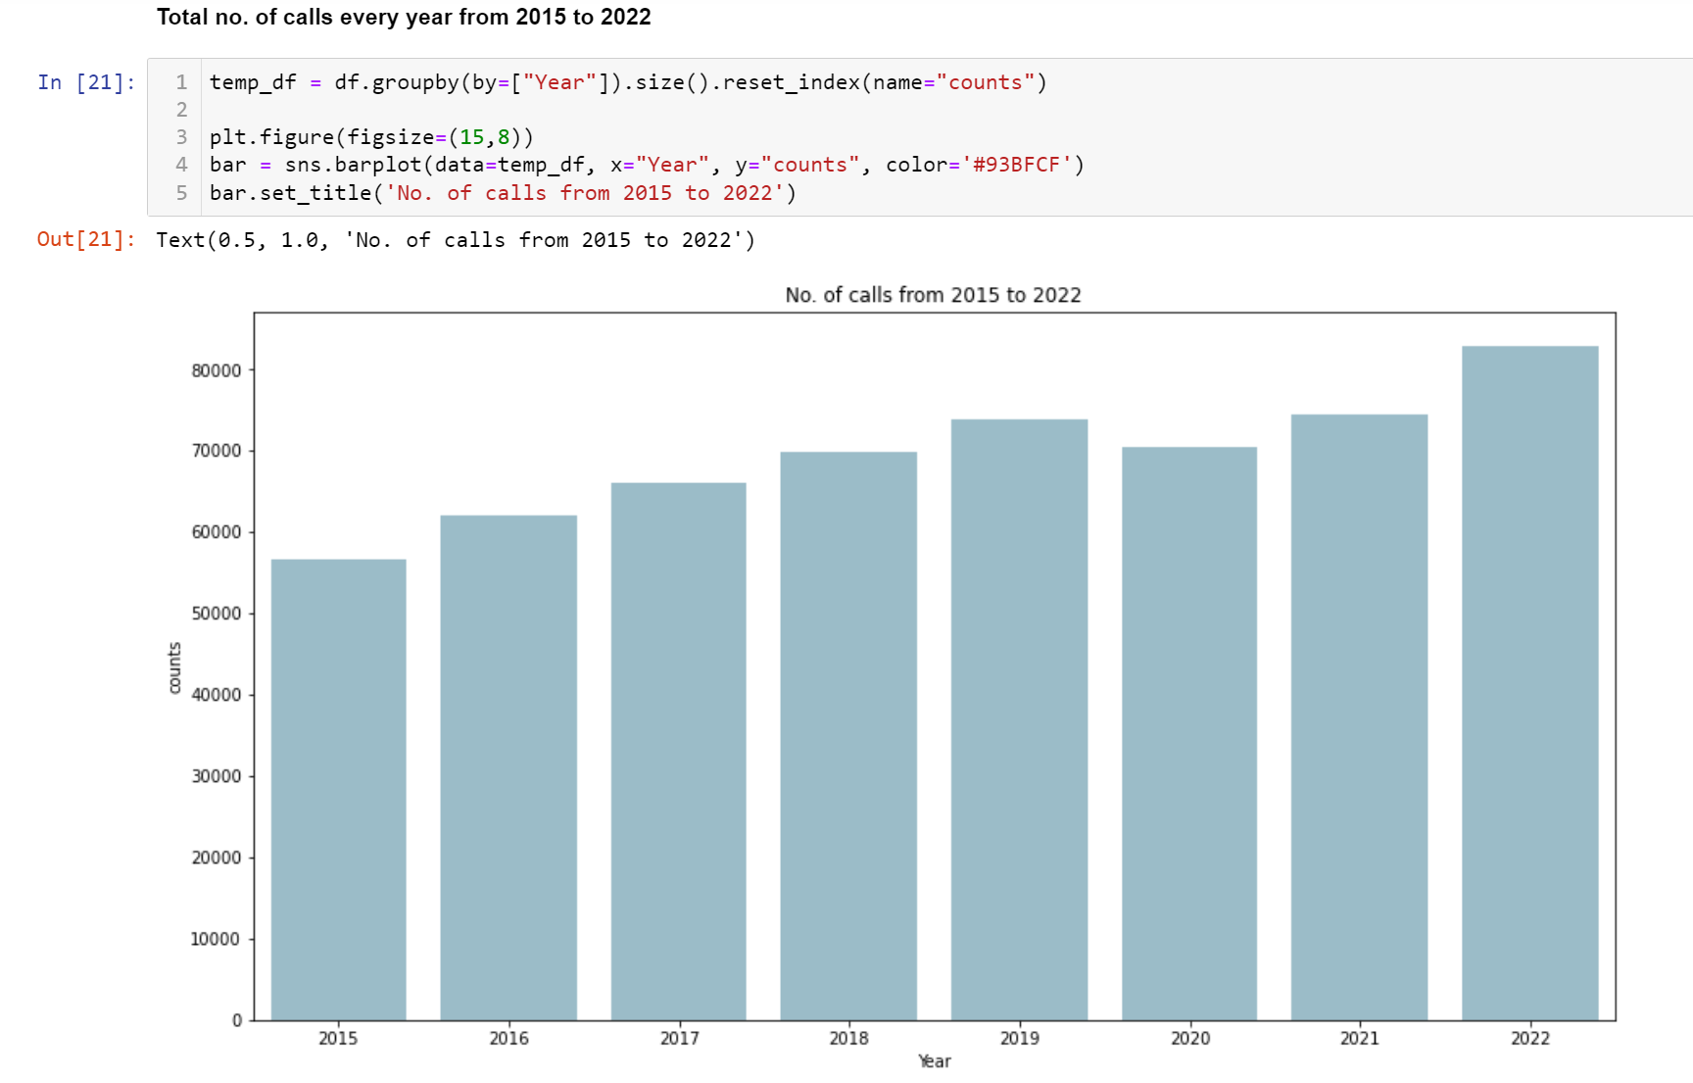
Working on Actual Data

Slide 22
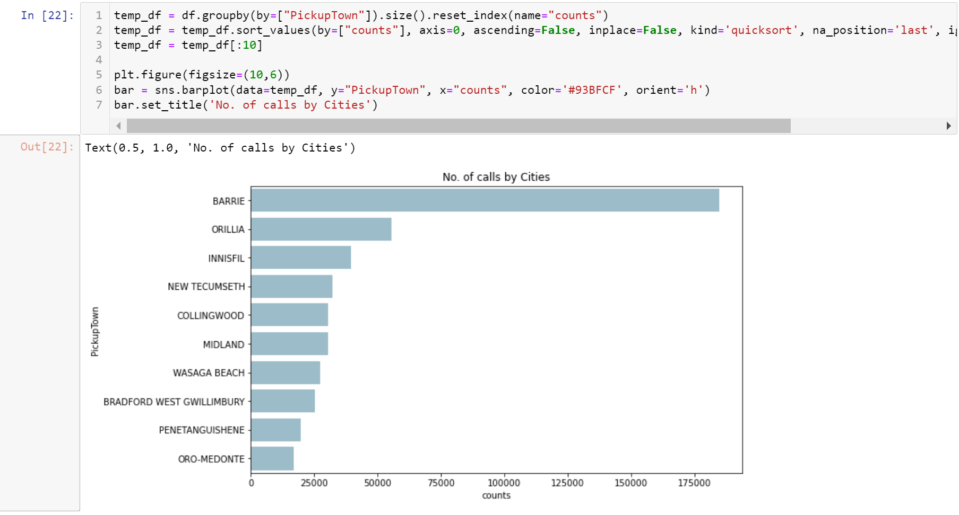
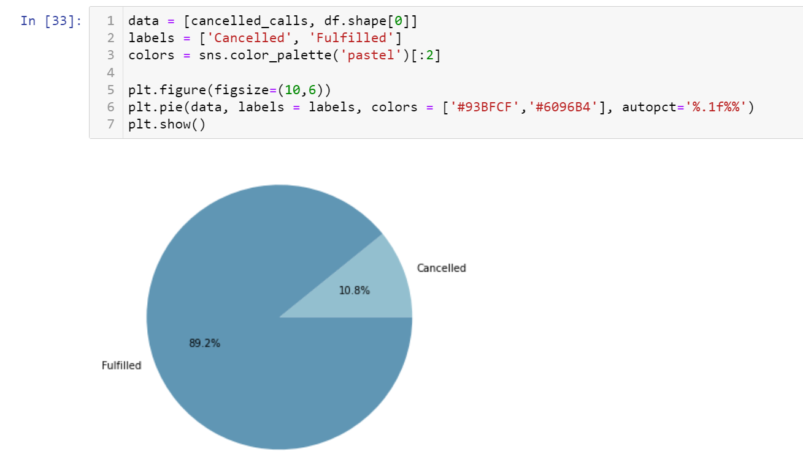
Working on Actual Data

Slide 23
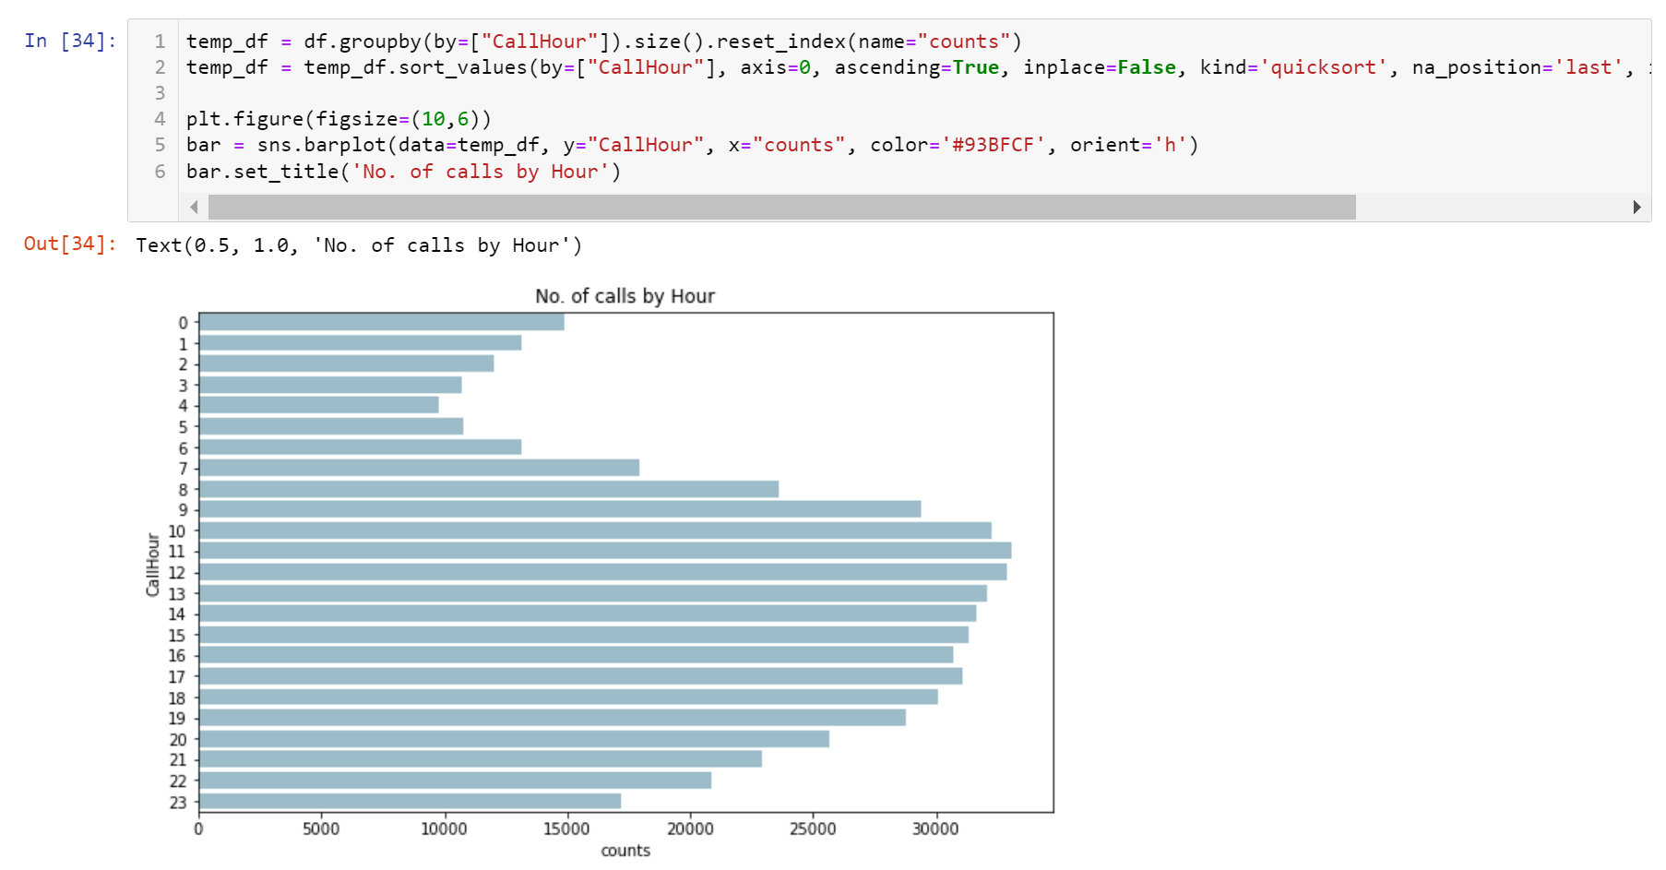
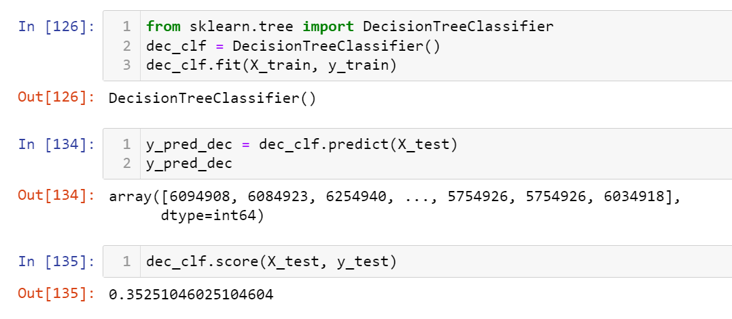
Working on Actual Data

Slide 24
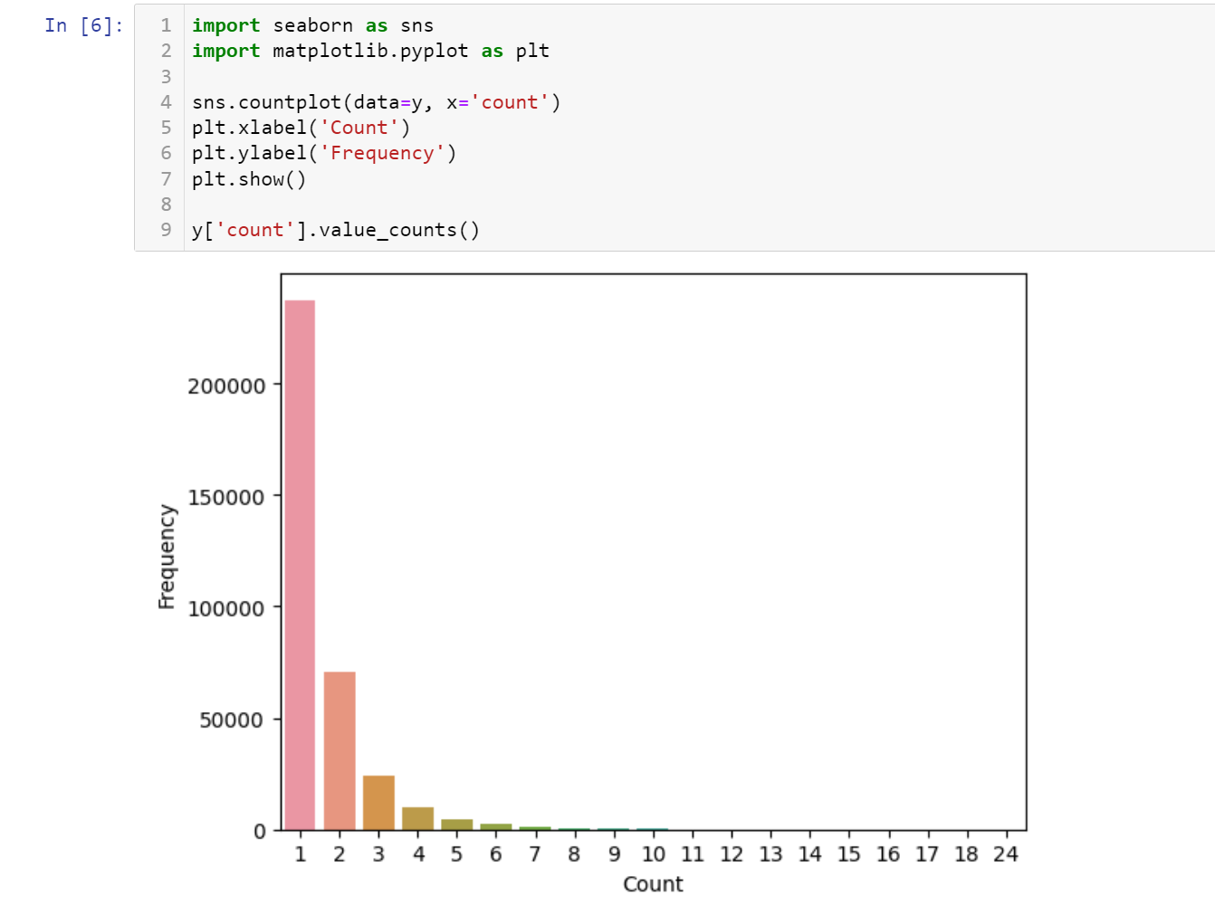
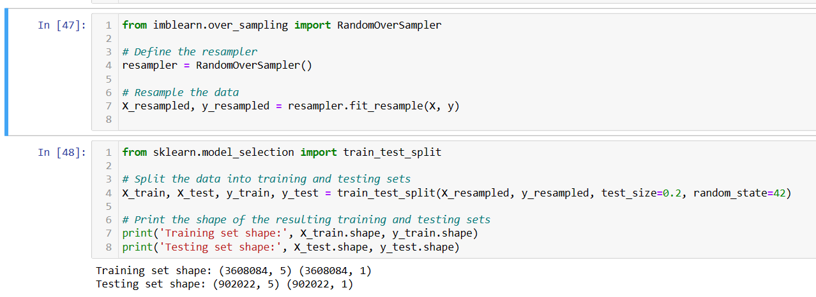
Working on Actual Data

Slide 25
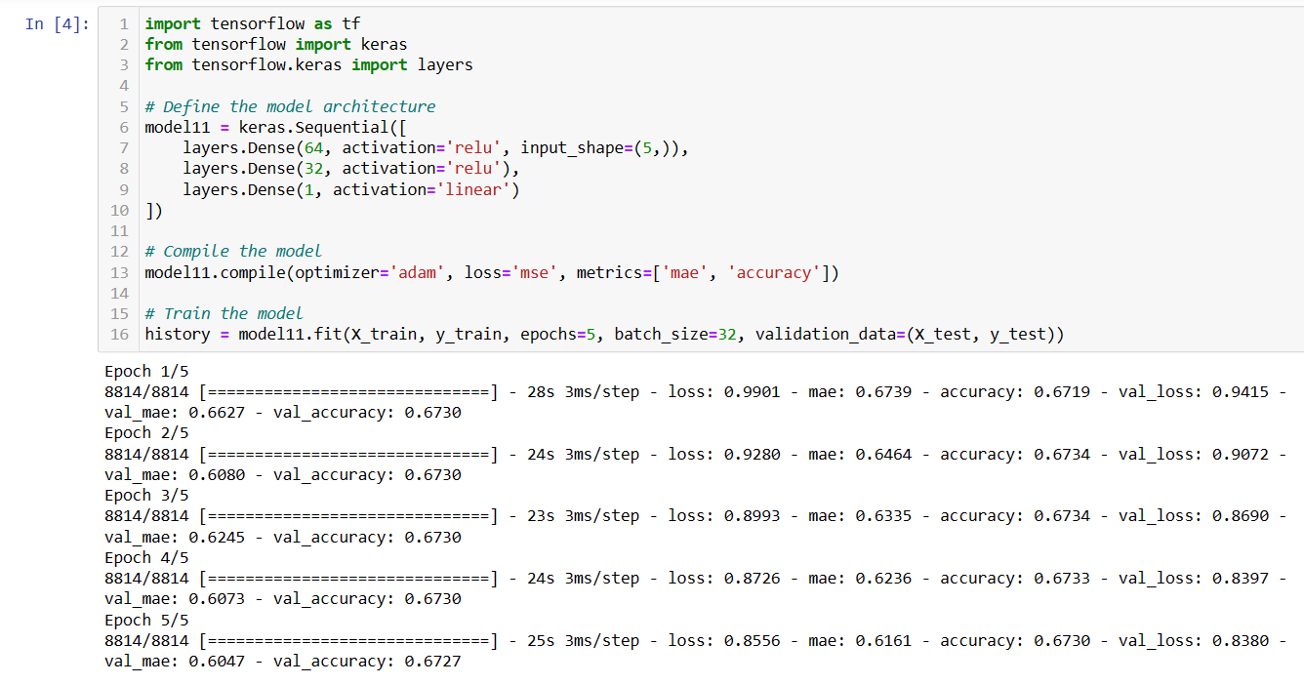
Working on Actual Data

Slide 26
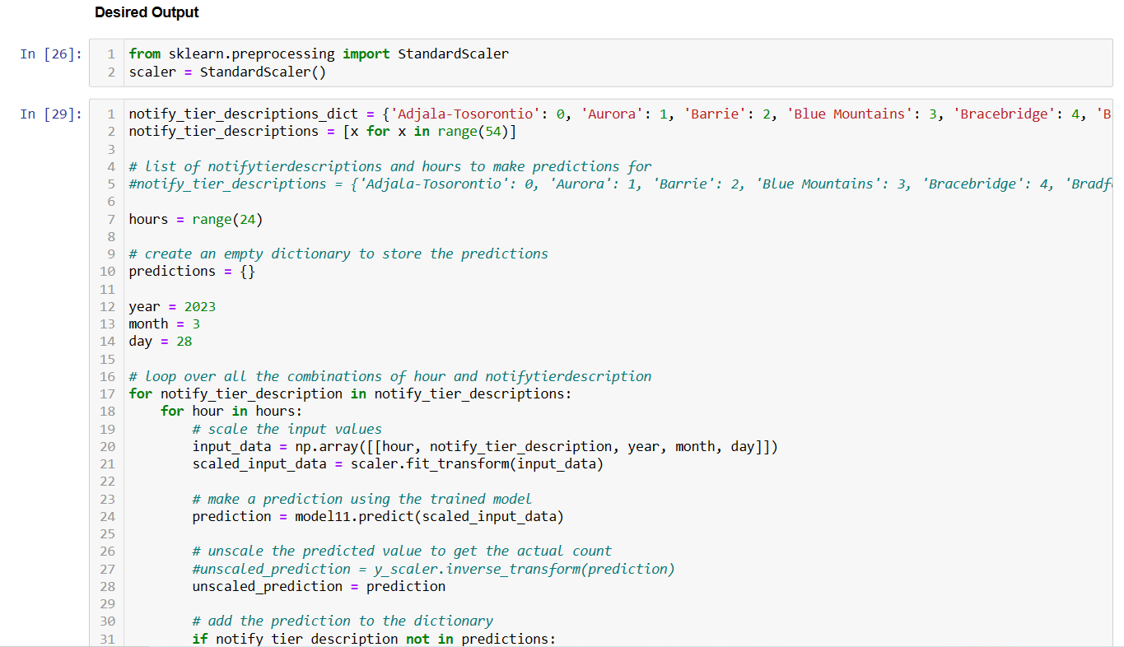
Working on Actual Data

Slide 27
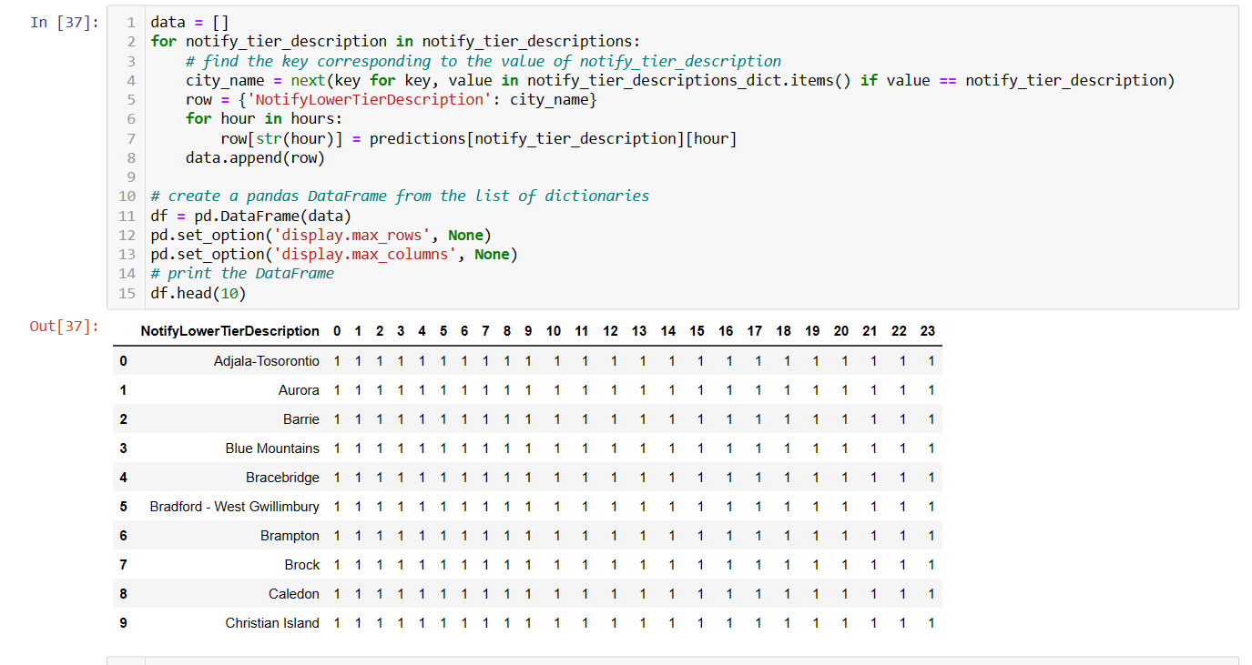
Working on Actual Data

Slide 28
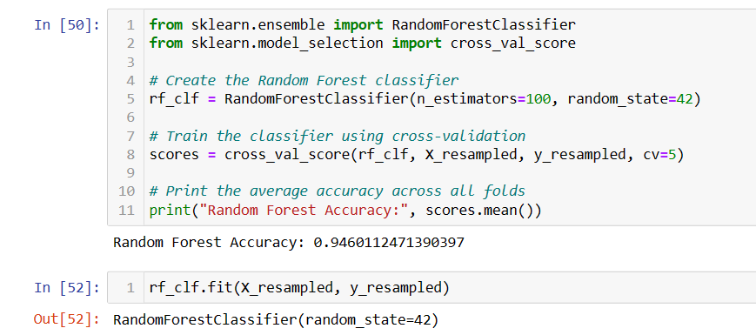
Working on Actual Data

Slide 29
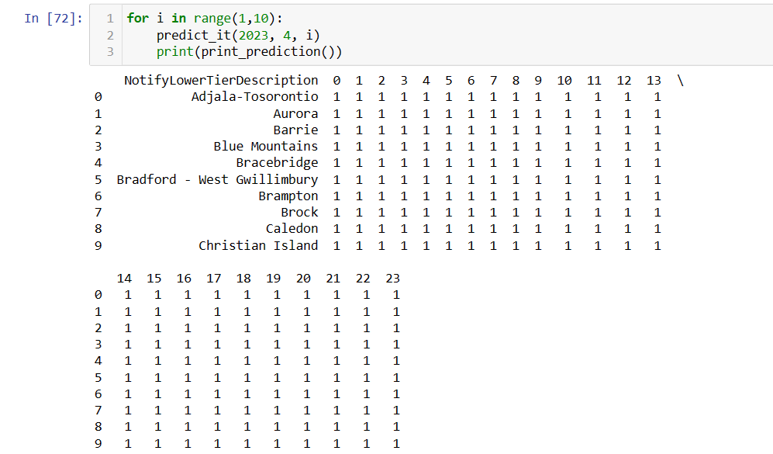
Working on Actual Data

Slide 30
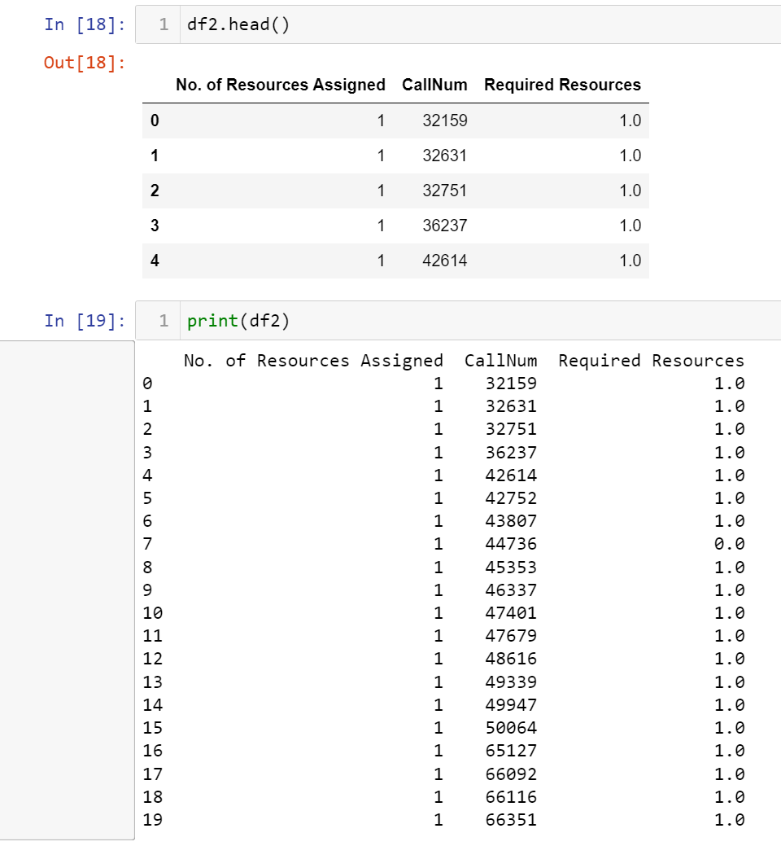
Working on Actual Data

Slide 31
Future Scope
We could create an API of this system and then it could be integrated an application. So, by just giving date as input, it will return the dispatch simulator for that date.
Moreover, over time there is need to add more data, leading to more accuracy and effectiveness.

Slide 32
Q & A

Slide 33
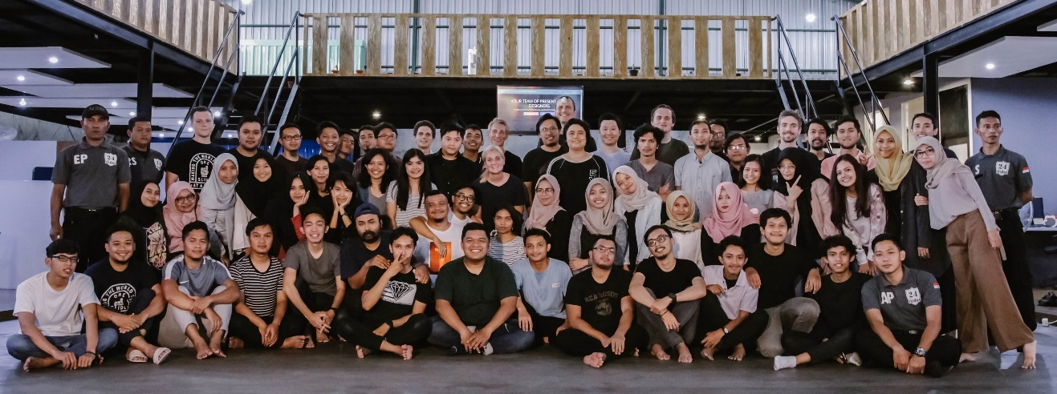

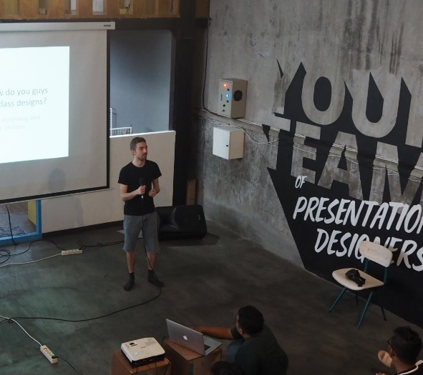
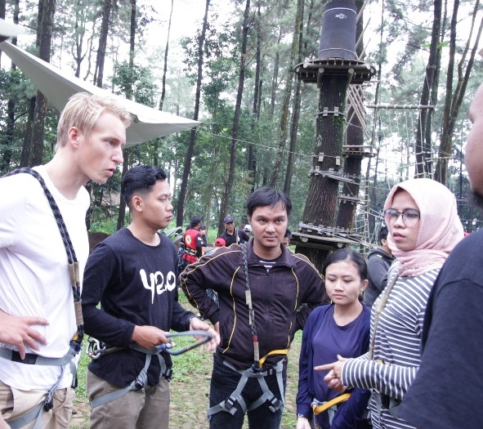
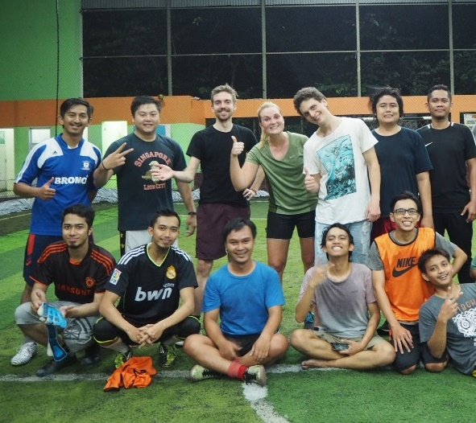


Thank you!

